Slide 1







Healthy High Street Belfast
Enhance-Promote-Support

Slide 2
Launch of Healthy High Street Belfast
We launched Healthy High Street with a presentation to the Belfast One BID board with the aim :
To Promote
  Promotion of local events & town partnership activity
  Sharing Information and Data
To Enhance
  Develop a ‘Start Up Toolkit’ for potential new businesses
  Identify locations for New Start Ups and Incubator Units
To Support
  Support Independents
  Offer work shadowing opportunities to secure talent pipeline

Slide 3
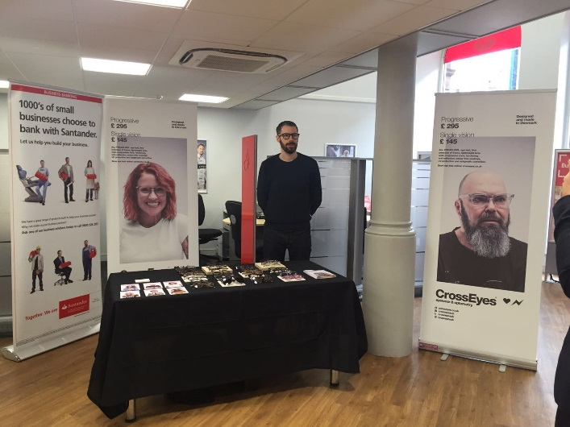
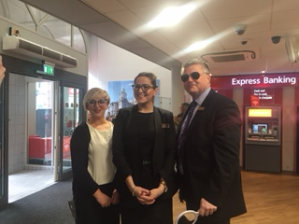
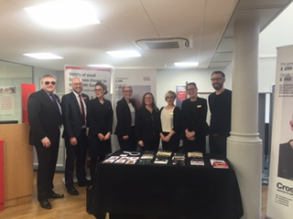
1ST Event
Our first project was to invite a local start-up business into our Santander branch to showcase his business.
This was a collaborative effort with Boots, M&S and Santander Staff participating
Paul Cooper owner of Crosseyes was invited to use our branch as a platform to advertise his company. Our branch customers were able to have an interactive experience with Paul and his product. Paul was grateful to able to showcase his business to a large group of people.
On average Santander Belfast will have approx. 500 customers transacting in branch.

Slide 4
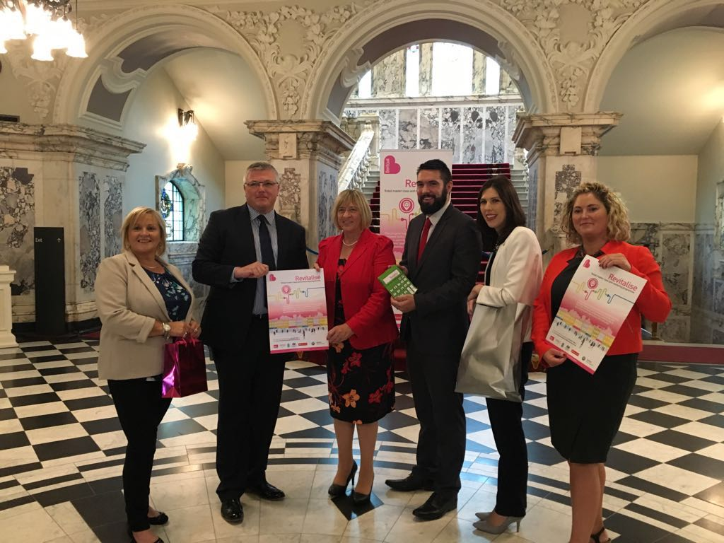
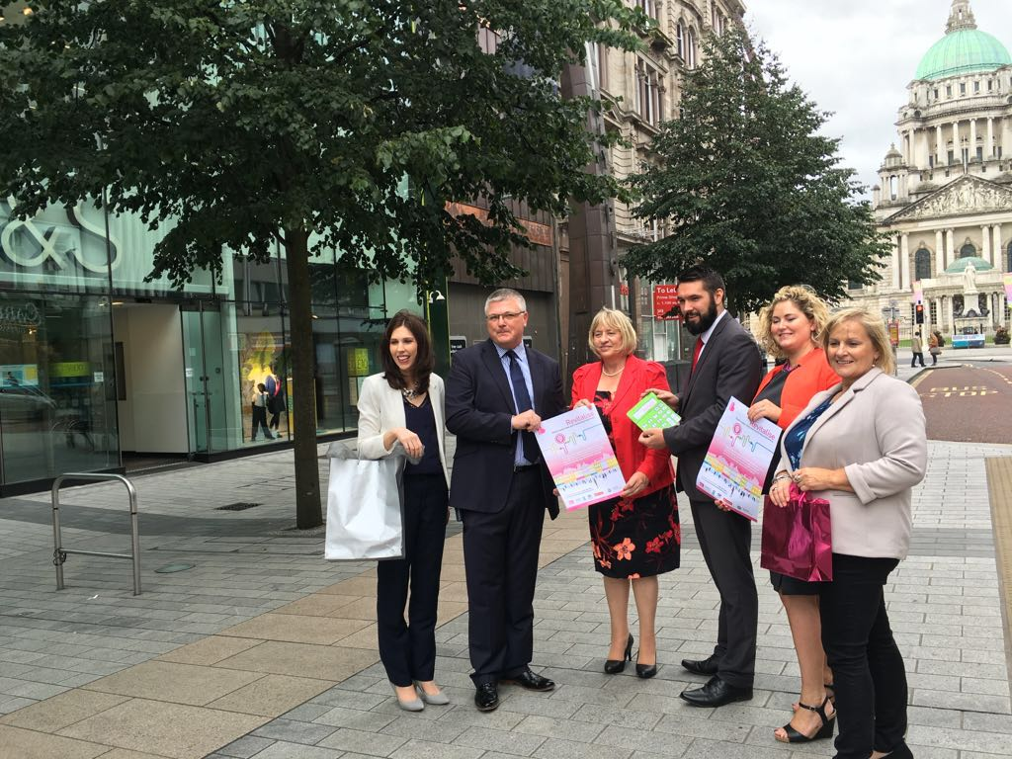
Revitalise
Small independent retailers in Belfast were offered the chance to enhance their retail skills and increase their business profitability via the Revitalise Programme.
Belfast City Council helped launch the programme for up to 30 new start and existing independent retailers through free targeted masterclasses and mentoring support.
Santander, Boots UK and M&S delivered the masterclasses and Belfast City Council provided the mentoring support to local businesses.

Slide 5
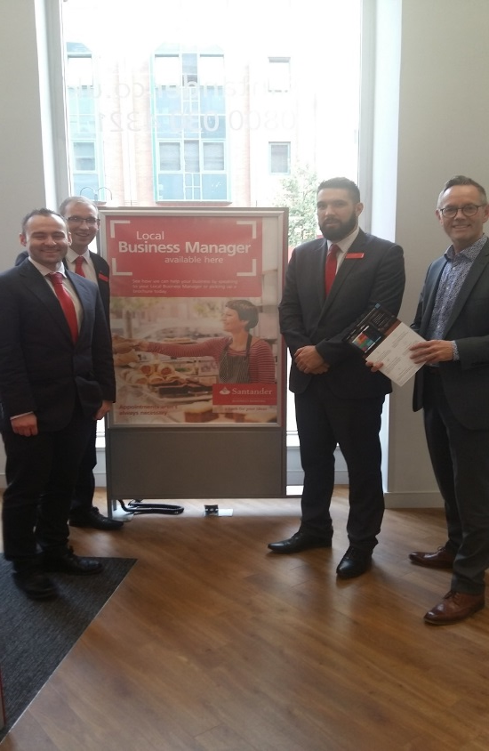

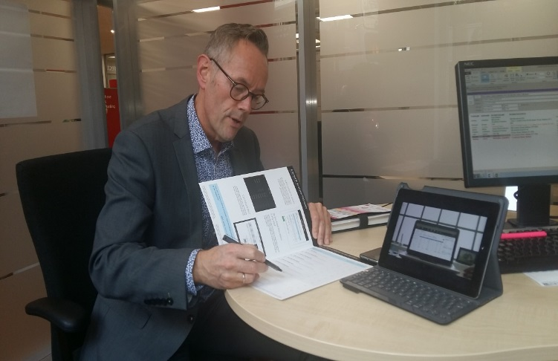
Finance Masterclass.
The first masterclass took place on Wednesday 24th August in the Santander Branch in Belfast Royal Avenue. Running throughout the day with drop-in sessions, the masterclass focused on financial planning with advise given on day-to-day business banking, savings and online banking service.
We also invited a business partner Elavon to offer demonstrations on merchant services and new online till terminals.
took place on Wednesday 24 August in the Santander branch in Belfast Royal Avenue. Running throughout the day with drop-in sessions, this masterclass focused on financial planning with advice given on day-to-day business banking, savings and online banking services.
Loans
Business Credit card
Overdraft
We where able to successfully offer finance of £20k for a customer who attend the masterclass.

Slide 6
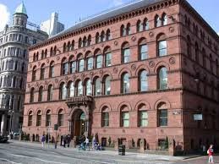
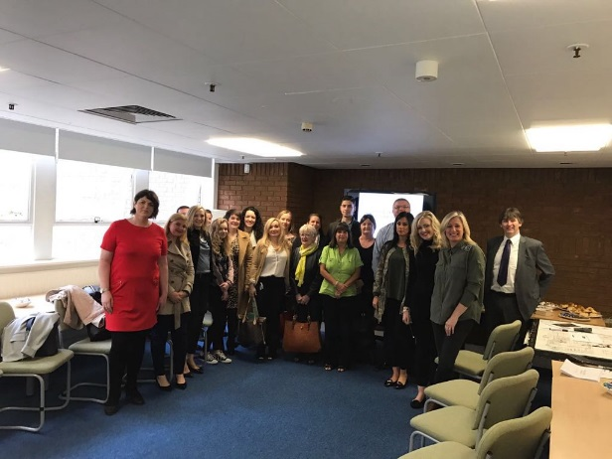
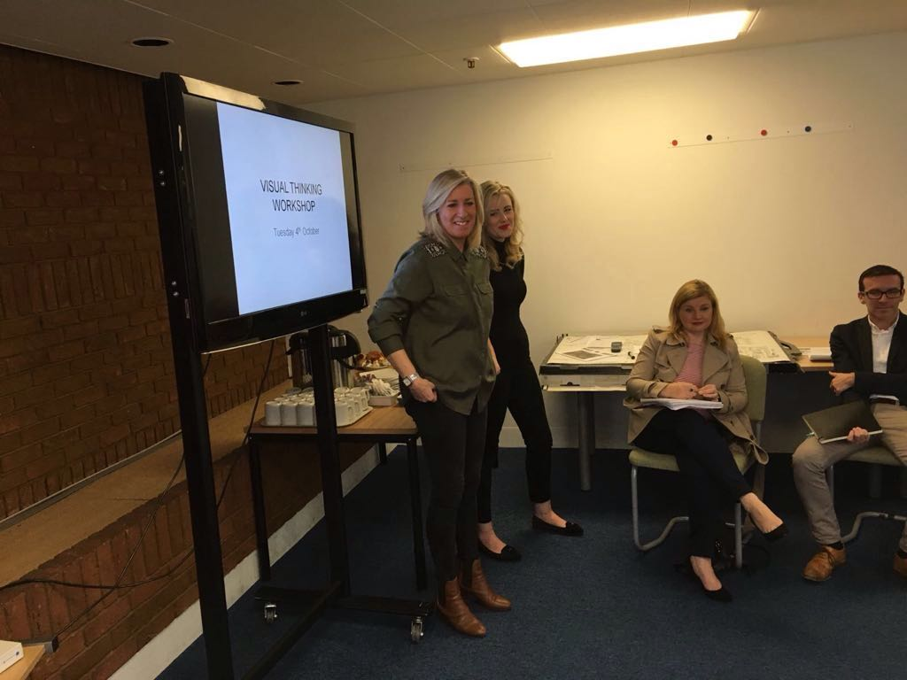
Visual Merchandising Masterclass
Marks & Spencer's Colin McGreevy & Julie Beattie ran this course covering all aspects of visual merchandising and display in retail today, and gave local businesses a thorough understanding of visual merchandising and its practical application. They explored creating themes, space planning and how to inject excitement into stores. There was a mixture of projects, lectures, and group discussions along with a tour of the M&S store which allowed businesses to see visual merchandising first hand.
Feedback received from Belfast City council was this was an excellent workshop with great responses from the attendees.

Slide 7
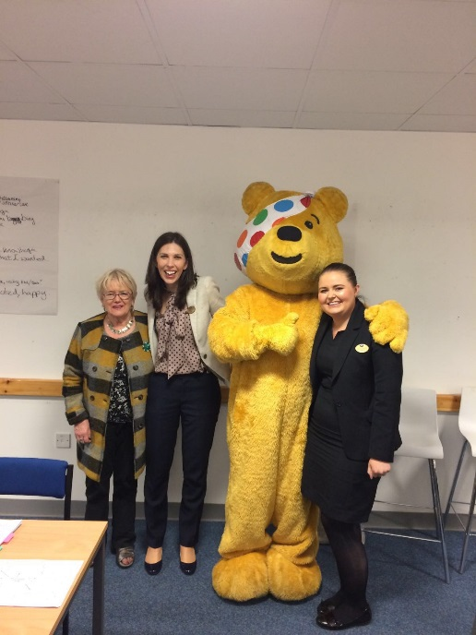
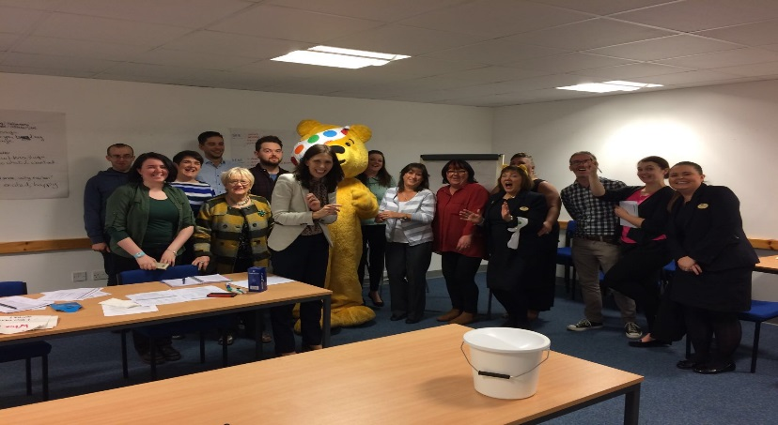
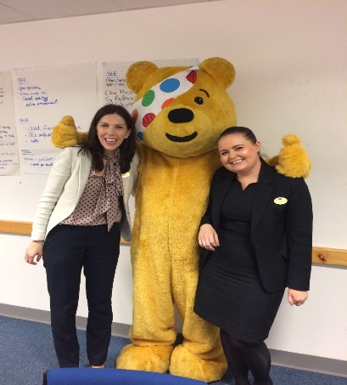
Delivering Great Customer Service Masterclass
The final masterclass was held on Wednesday 26 October in the Boots store in Donegall Place. Aileen McGroggan focused on the delivery of great customer service. This combined seminar and workshop session. The attendees where encouraged to visit other retailers in the city in a mystery shopping format to then return to discuss their findings in a group environment.
Again another great turn out with excellent feedback received. Feedback forms submitted.

Slide 8

The Future of Healthy High street
After our successful events in 2016 – we are aiming to keep our relationship strong and support each other in upcoming events.
Breakthrough in branch (Trading in a digital age) Santander 21st March 6-8pm.
  Santander Business networking event - Our aim is deepening relationships with new and existing customers in the community, enabling us to help people and businesses prosper.
  We want to connect with like-minded people looking to build a successful business and also to give you tips and advice around trading in a digital world.
Our Business partner Elavon will be speaking to educate businesses on:
  1. New and emerging payment methods.
  2. How to maximise sales through their online channel.
  3. The latest point of sale technology.
Also on our panel is Linzi Rooney - director of Studio Souk, a retail space for a collection of local designers in Belfast.
  As a customer of ours she will speak about her journey so far in the world of business.
We will hold a Q&A session with our panel that will allow attendees to deepen their understanding an gain valuable knowledge.

Slide 9
The Future of Healthy High street
Marks & Spencer, Boots and Santander will now all attend Belfast City Centre Management’s monthly Retail Steering Group to keep ourselves involved and up to date with what's happening in the city and its performance.
Marks & Spencer will be represented on Belfast One’s Promote Working Group.
Santander will be represented on Belfast One’s Enhance Working Group.
Boots will be represented on Belfast One’s Support Working Group

Slide 10
What's worked well
We have all found that being able to contact each other is very important. We have set up a WhatsApp group so we can keep in regular contact.
We try and meet up at least once a month to touch base and promote each others events.

