Slide 1
Belfast Grand Central Station
Street Works Programme Works
(please note – dates are TBC)

Slide 2
Background
As part of the award of the construction to the main works elements of the Grand Central Station, this award included a significant update to the local roads network.

Slide 3
Purpose of the Presentation
Following a significant design development & approvals period, we are now ready to move into the Construction Phase of the works in 2024 and 2025.
This presentation, is designed to give key stakeholders a clearer idea of when and for how long each section of the work is currently planned.

Slide 4
Street Work Phases
Phase One: Streets that will be complete prior to station opening.
Phase One*A: Sandy Row Street Upgrades (which has no direct link to station opening)
Phase Two: Streets that will be complete after the station opening

Slide 5
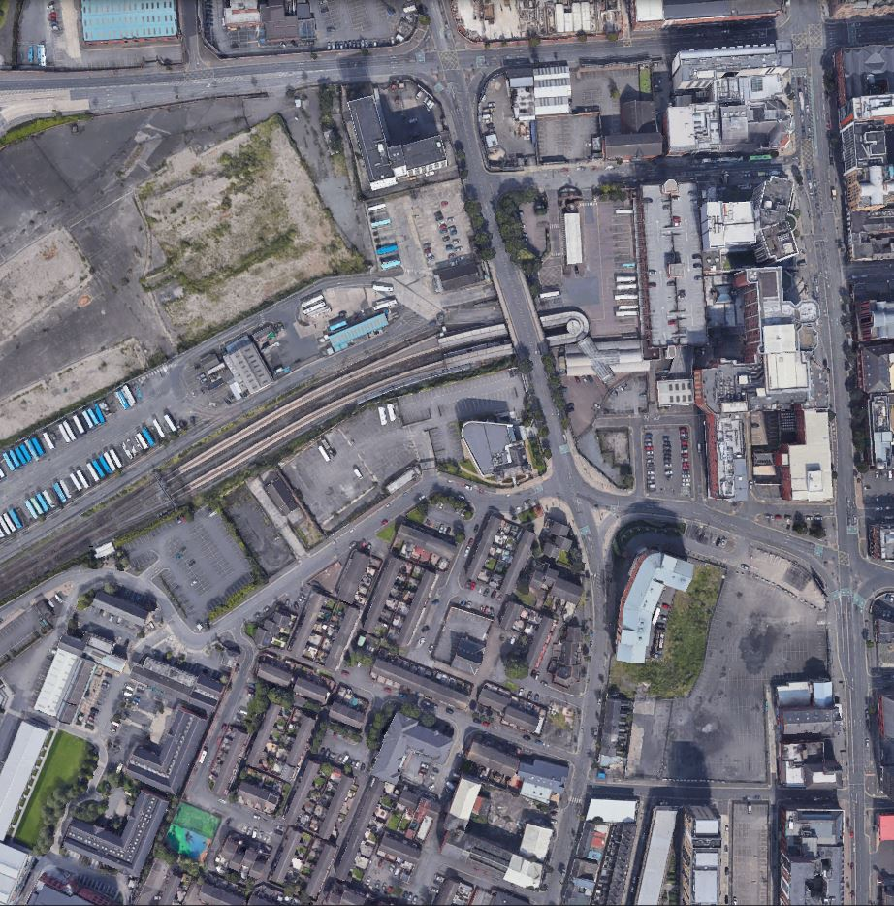
Google Street View
Overall Works

Slide 6
Google Street View
Overall Works

Slide 7
Phase 1 Street Footpath Works in Yellow

Slide 8
Phase 1 Street Footpath Works in Yellow
Grosvenor Road - Lane / footpath Closure only - April to September 2024
Glengall Street Section 1 – Lane / footpath closure. April/May to June 2024
Great Victoria St Crossing / footpath alignment – Lane / footpath closure – May to August 2024

Slide 9
Phase 1A – Sandy Row Footpath Resurfacing
Proposed dates for this work: May to September 2024 - TBC
This would be completed as lane closures only to facilitate the works

Slide 10
Phase 2 – Durham Street & Hope Street
Temporary Local Access
Durham Street Complete Closure
October 2024 to July 2025
Hope Street Footpath Realignment
Lane / footpath Closure only – March 2025 to September 2025

Slide 11
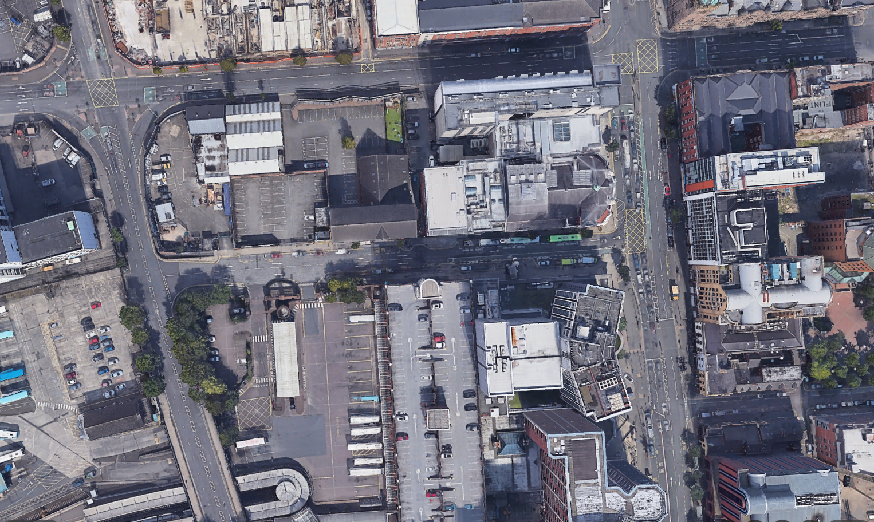
Phase 2 – Glengall Street
Section 3 – Green
March to June 25
Section 2 – Purple
Jan – March 25
Section 4 – Blue
July to October 25
Section 1 – Yellow Phase 1
April to June 2024

Slide 12
Phase 2 – Great Victoria Street
Paving to front of Grand Opera House & Fitzwilliam Hotel
July to October 2025
New Kerb Alignment to outside Europa and Existing Station / Taxi Rank
July to October 2025
Works to Amelia Street Entrance and Pedestrian Crossing – July to October 2025

Slide 13
Google Street
View
Resurfacing Programme:
These works will be short duration, and will take place in 2025

Slide 14
End of Presentation
Questions
Further information requested
Follow up progress / technical meetings if required

